Slide 1
SQL IN A SERVER ENVIRONMENT

Slide 2
Objectives
The typical server environment
SQL terminology for client – server computing and connecting to a database
Embedding SQL within programming language
Combining SQL with general – purpose programming
The SQL standard library called SQL/CLI
JDBC and PHP

Slide 3
The three – tier Architecture
A very common architecture for large database installation
Three different, interacting functions
Web servers
Application servers
Database servers
The processes can run on the same processor or on a large number of processors

Slide 4
The three – tier Architecture
Database
Database Server
Database Server
Database servers receive data requests from applications
Database is accessed through database servers only
There can be many processes in the database tier
The processes can be in one or many machines
Application Server
Application Server
Application Server
The application server processes execute the business logic of the organization based on data providing from database servers (if required)
App. servers perform processes as posed by webserver applications
Web Server
Web Server
Web Server
Web Server
The webserver processes manage the interactions with the user
Internet
Client
Client
When a user makes contact, a webserver response to the request, and the user becomes its client

Slide 5
STORED PROCEDURES

Slide 6
Introduction
Persistent, Stored Modules (SQL/PSM)
Help to write procedures in a simple, general-purpose language and to store them in the database

Slide 7
Creating PSM Functions and Procedures
Modules = collections of
Function definitions
Procedure definitions
Temporary relation declarations
Several other optional declarations

Slide 8
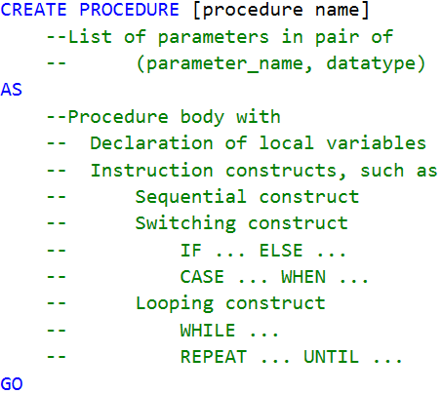
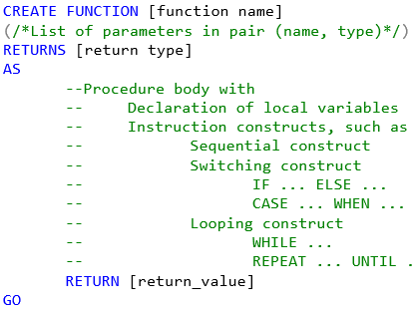
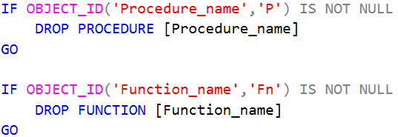
Creating, Dropping PSM Functions and Procedures
Unlike to other programming languages, SQL procedures may return values as functions do.
That’s why we use procedures instead of functions in our works.
Now, let’s start by examples

Slide 9

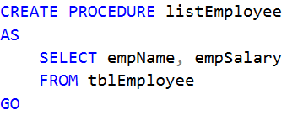
The First Ever Example about SQL Procedure
R: Display name and salary of all employees without using SELECT
statement directly due to security issues
In this case, the following statement is not suitable (WHY?):
Possible solution is a procedure as followed:
Then, we call this procedure to get required results:
This solution provides the same result, but more secured. WHY?

Slide 10

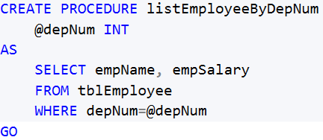


Using ‘normal’ parameters in SQL Procedure
R: Display name and salary of all employees based on value of
department number, which is given in case by case.
For each department number (i.e. 1), we can use:
Then, we must change the value of depNum. This is inconvenient.
Better solution is a procedure with depNum as a parameter:

Slide 11
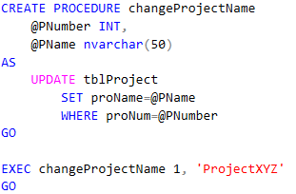
Data Modification in SQL Procedure
R: Do a change of given name for given project number

Slide 12
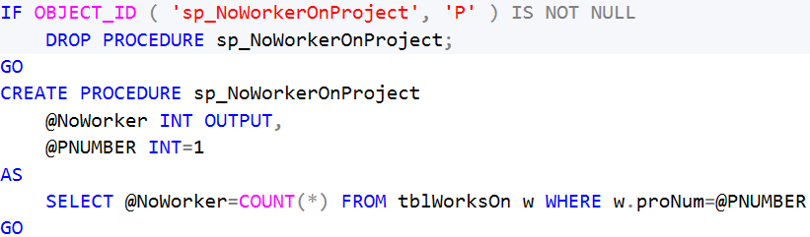


SQL Procedure with OUTPUT parameter (NO RETURN)
R: Get number of workers on given project number
R: How to call this procedure?

Slide 13
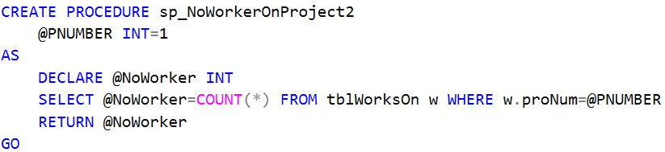

SQL Procedure with RETURN statement
R: Get number of workers on given project number

Slide 14
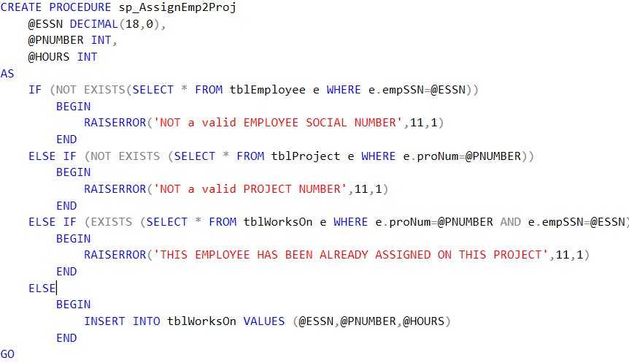
SQL Procedure with Error Handler
R: Assign given employee (by SSN) into given project (by Number)
with given working hours per week

Slide 15
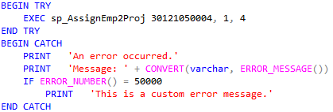

Catching Error in Execution

Slide 16
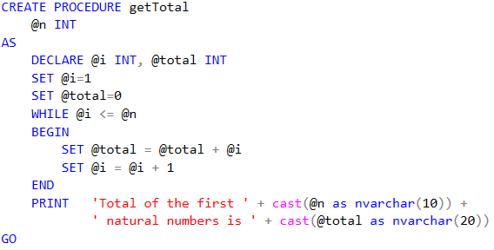


Looping in SQL Procedure
R: Get total of given number of first natural numbers

Slide 17
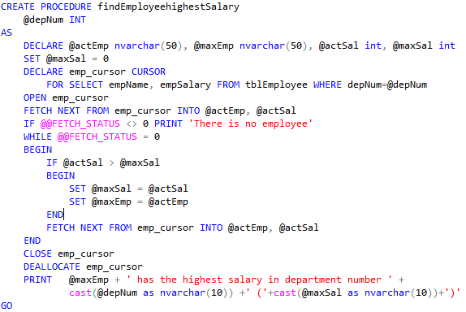
Using Cursor in SQL Procedure
R: Find employee name, who has the highest salary in given department name

